Slide 1
面向行业应用的自然语言处理课程中期答辩
THESIS DEFENSE PPT
答辩人：周绪睿

Slide 2
CONTENTS
目录
01
绪论
02
课题分析
03
实验结果与分析
04
学习内容分享
05
总结与展望

Slide 3
01
绪论
INTRODUCTION

Slide 4

01
绪论
INTRODUCTION
近期工作总结
最近的工作总体分为两部分：项目的继续研究，NLP相关知识的学习。
在看模型代码和论文的过程中遇到了一些瓶颈，然后博士学长建议我先暂停多模态方向的学习，先把NLP的深度学习模型都比较细致的了解一遍。
然后这段时间的安排就侧重基础知识学习多一些。另外在项目方面进行了调试以及有了一些改进思路。

Slide 5
01
绪论
INTRODUCTION
Text Classification
Generative & Discriminative
Classic & NN based
Seq2Seq and Attention
Seq2Seq Basics
Attention
Transformer
04
NLP不同任务学习
01
03
Transfer Learning and Pretrained Models
CoVe & ELMo
GPT & BERT
Language Model
N-Gram LMs
NN LMs
02

Slide 6
01
绪论
INTRODUCTION
课题分析
研究课题工作
实验结果分析

Slide 7
02
课题分析
RESEARCH METHODS AND IDEAS

Slide 8
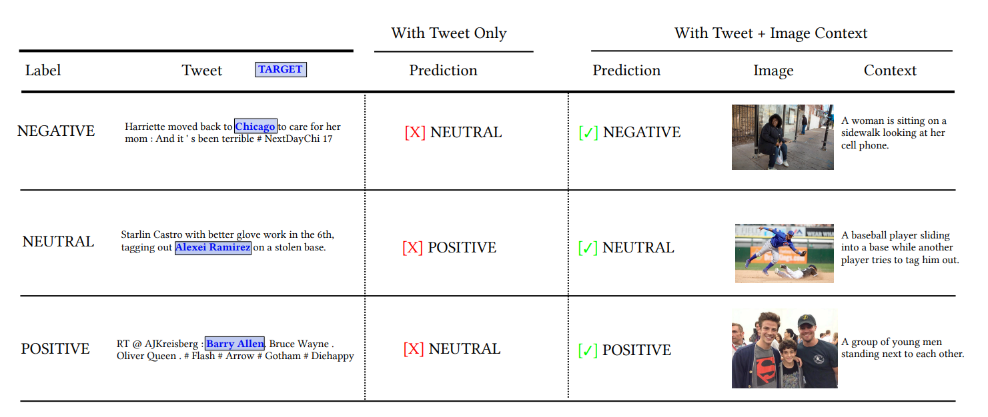
02
课题分析
RESEARCH METHODS AND IDEAS
Multimodal target/aspect sentiment classification combines multimodal sentiment analysis and aspect/target sentiment classification. The goal of the task is to combine vision and language to understand the sentiment towards a target entity in a sentence.

Slide 9
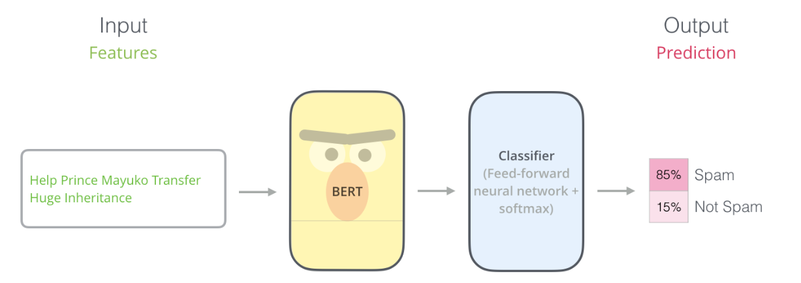
02
课题分析
RESEARCH METHODS AND IDEAS
Problem Analysis:
Take this for an example

Slide 10
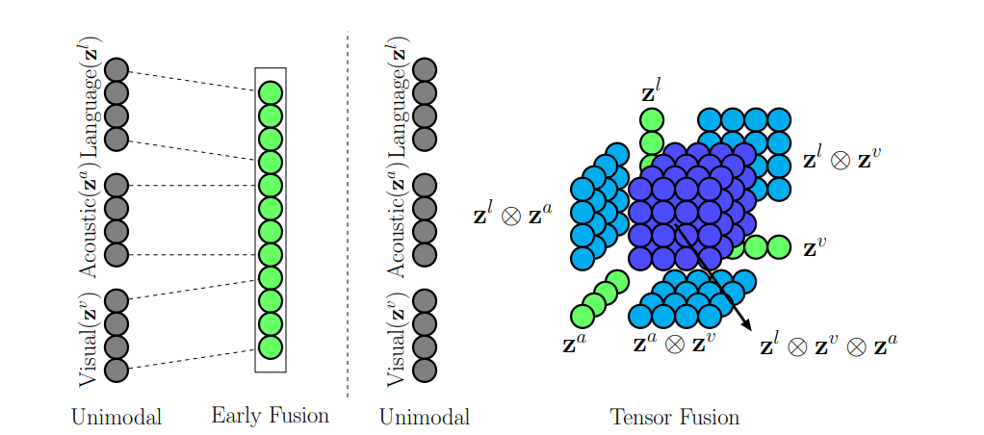
02
课题分析
RESEARCH METHODS AND IDEAS
Multimodal Feature Fusion
Current methods jointly embed both the visual information and the textual feature into the same space.
Here are some of these kinds of methods:
We can use deep Convolutional Neural Networks (CNNs) to represent images and Recurrent Neural Networks (RNNs) to represent sentences or phrases. The extracted visual and textual feature vectors are then jointly embedded by concatenation, element-wise sum or product to infer the answer.
From Tensor Fusion Network for Multimodal Sentiment Analysis

Slide 11
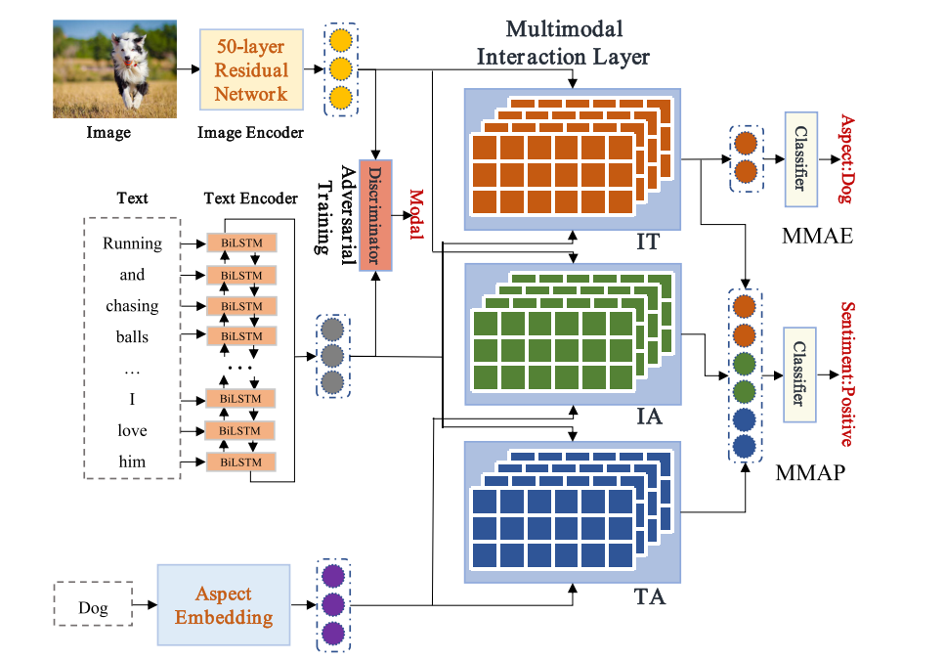
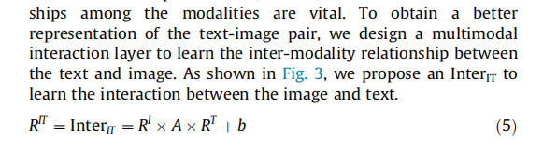
02
课题分析
RESEARCH METHODS AND IDEAS
From MASAD: A large-scale dataset for multimodal aspect-based sentiment analysis

Slide 12

02
课题分析
RESEARCH METHODS AND IDEAS
But Many researches argue that such simple kinds of merging might not be expressive enough to fully capture the complex associations between the two different modalities. And they also put forward some more complex and effective methods such as Multimodal Compact Bilinear pooling method (MCB), and different NN structures.
Emm...

Slide 13
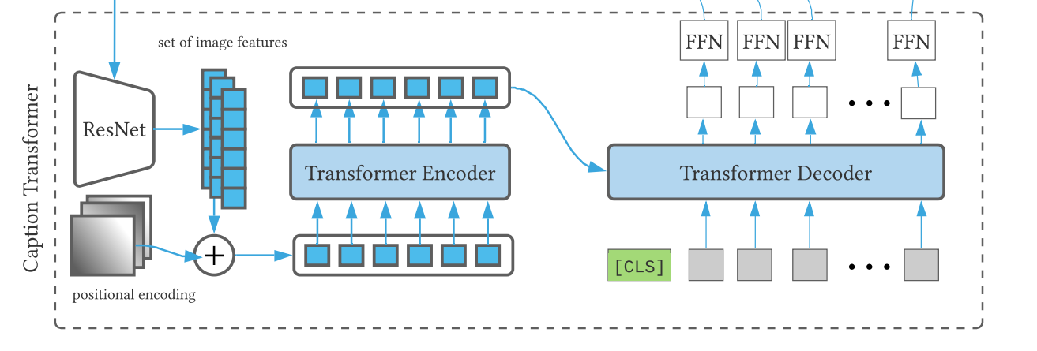
02
课题分析
RESEARCH METHODS AND IDEAS
No Multimodal Feature Fusion?
Converting to one same modal space may be a good idea.
From Exploiting BERT For Multimodal Target Sentiment Classification Through Input Space Translation
Different from exploring the high dimensional and noisy image feature vectors to infer the answer, we can express the image explicitly by natural language. Compared to image feature, natural language represents a higher level of abstraction and is full of semantic information. In addition, the complex multimodal feature fusion problem can be avoided.

Slide 14
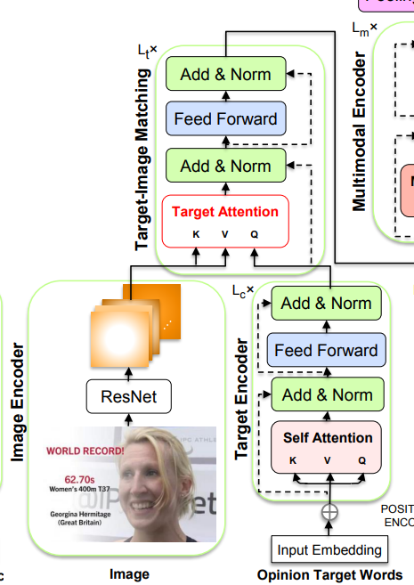
02
课题分析
RESEARCH METHODS AND IDEAS
Well Designed Feature Fusion?
Capture the relation between imagines and oriented target.
Since the BERT model can help derive contextualized word representations with pre-trained model parameters from a large corpus and enjoy the capability of learning alignment between two arbitrary inputs, we can leverage it as the base model for this kind of task.
Use the attention mechanism to perform matching between the target and the image to obtain a target-sensitive visual representation
From Adapting BERT for Target-Oriented Multimodal Sentiment Classification

Slide 15
03
实验结果与分析
KEY TECHNOLOGIES AND PRACTICAL DIFFICULTIES

Slide 16
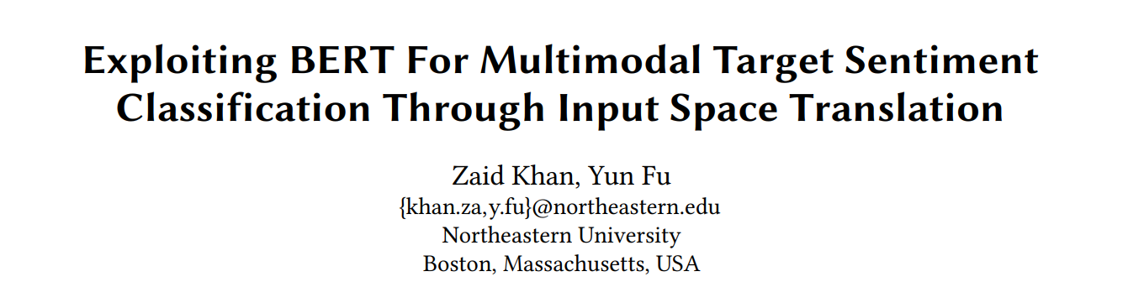
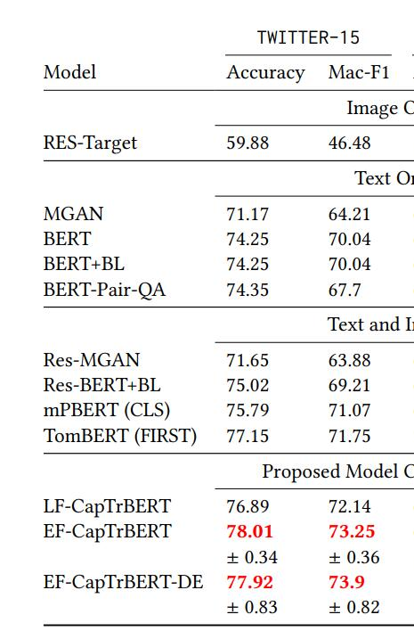
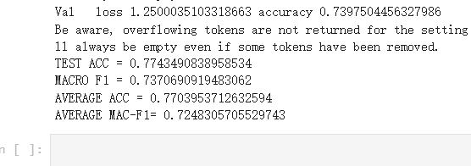
03
实验结果与分析
KEY TECHNOLOGIES AND PRACTICAL DIFFICULTIES
I tested the model and methods proposed from this paper:

Slide 17
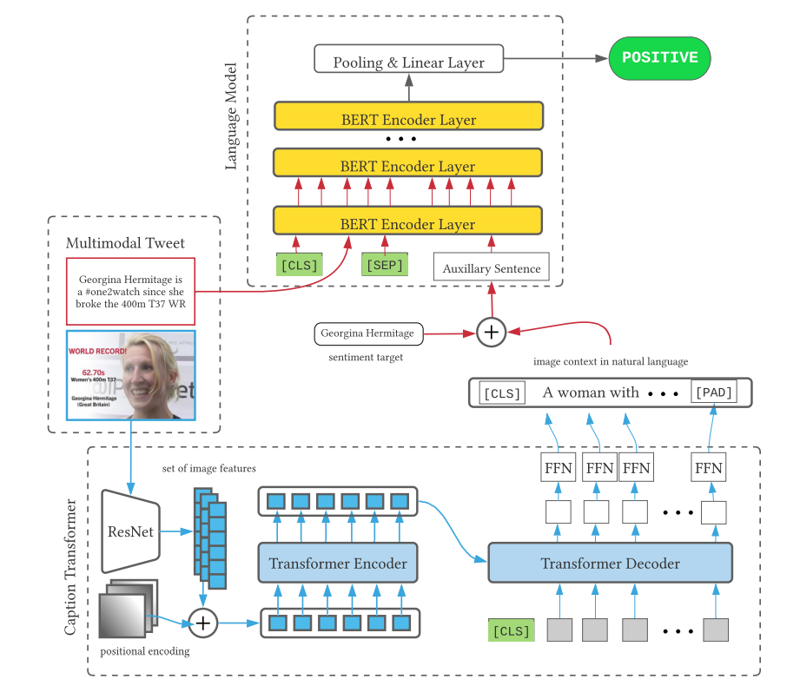
03
实验结果与分析
KEY TECHNOLOGIES AND PRACTICAL DIFFICULTIES
Here are the problems…
The best score is always lower than the average score proposed by the paper and the result is fluctuating(not stable).
If we just use the pure text input with tweetbert, and even without image converting and fusion, the score is higher than the paper’s best result.
It seems that the image caption does not make sense in this model...
If we use the end-to-end learning instead of 2-stage caption learning, the result is better.

Slide 18

03
实验结果与分析
KEY TECHNOLOGIES AND PRACTICAL DIFFICULTIES
My idea:
It seems that we just didn’t make full use of the image information.
What about a well designed fusion added to Bert?
End-to-End here

Slide 19
04
学习内容分享
RESEARCH RESULTS AND APPLICATIONS

Slide 20
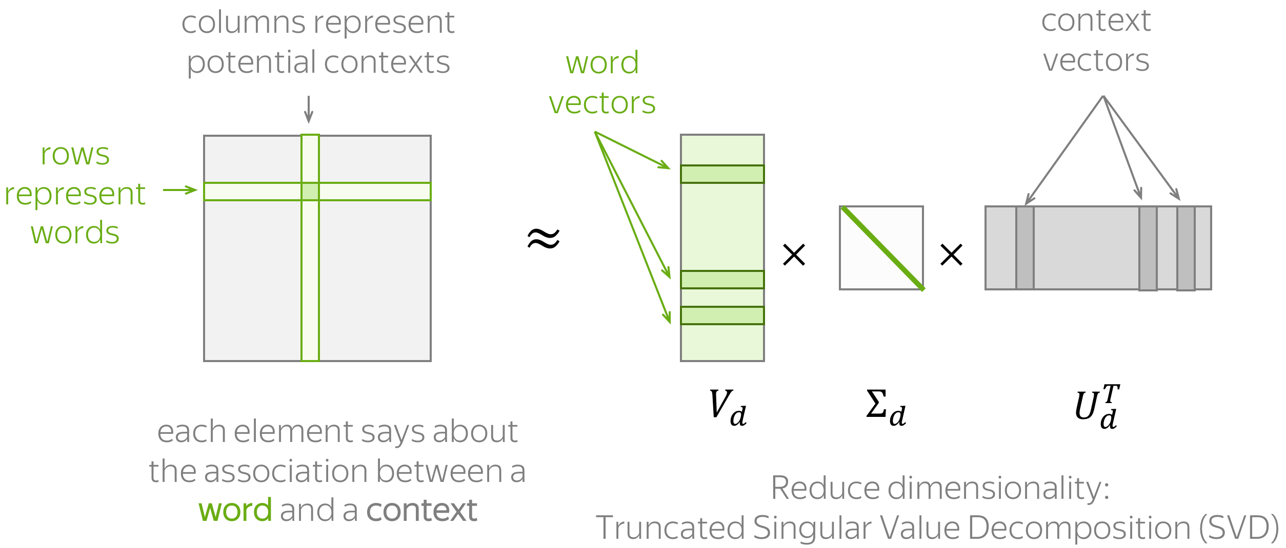
04
学习内容分享
RESEARCH RESULTS AND APPLICATIONS
Distributional Semantics Hypothesis
Words which frequently appear in similar contexts have similar meaning
WordEmbedding
Count-Based Methods
Main idea: We have to put information about contexts into word vectors
Count-based methods take this idea quite literally:
How: Put this information manually based on global corpus statistics.
Here are some methods to model the association:
Co-Occurence Counts
Positive Pointwise Mutual Information (PPMI)
Latent Semantic Analysis (LSA): Understanding Documents

Slide 21
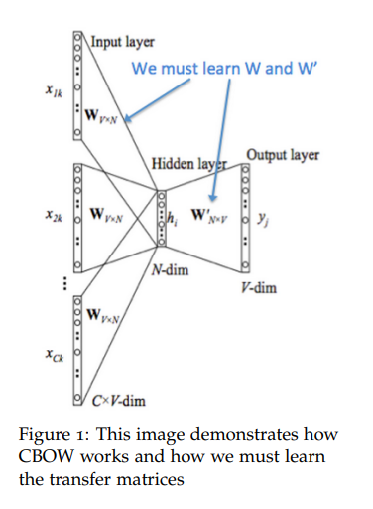
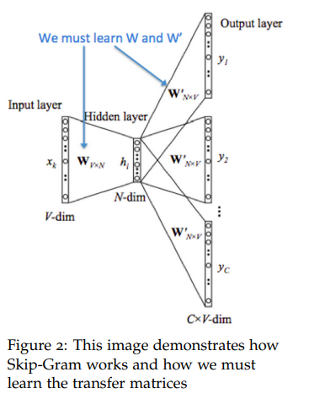
04
学习内容分享
RESEARCH RESULTS AND APPLICATIONS
Word2Vec
The detailed models are quite simple, I will not introduce them here, but I’m going to talk about deeper understanding.

Slide 22
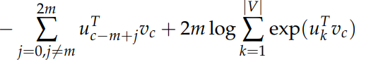
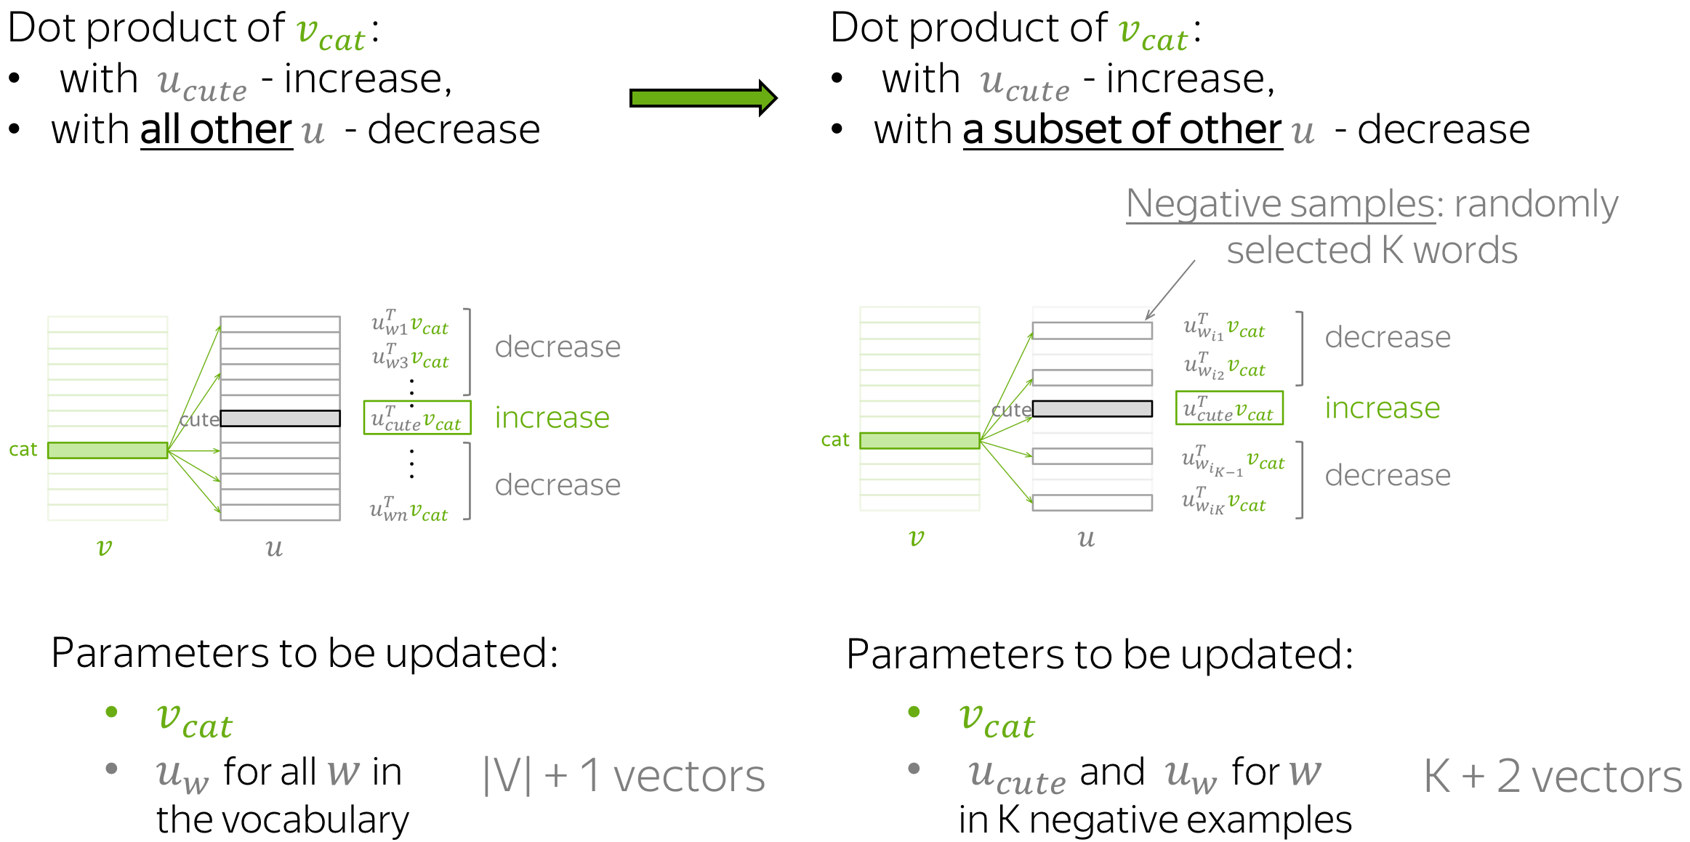
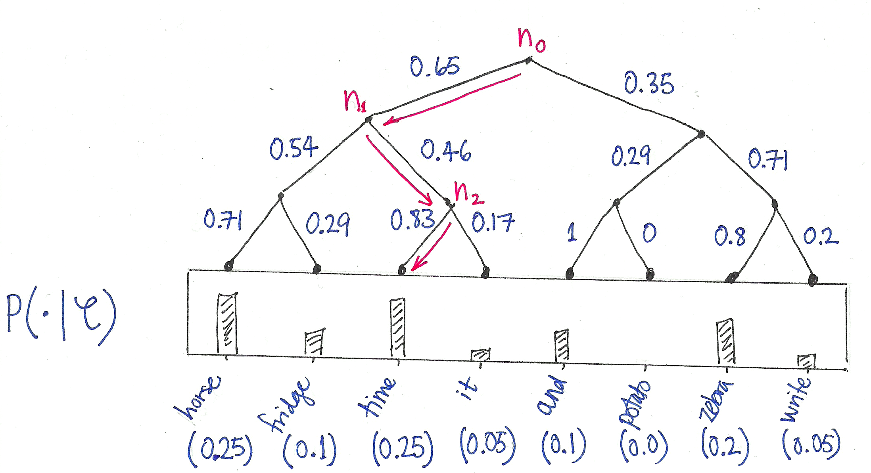
04
学习内容分享
RESEARCH RESULTS AND APPLICATIONS
Improvement Motivation
Note that the summation over |V| is computationally huge! Any update we do or evaluation of the objective function would take O(|V|) time which if we recall is in the millions.
Negative Sampling
- context vectors not for all words, but only with a subset of K "negative" examples
- New Objective function using sigmoid
Hierarchical Softmax
Hierarchical Softmax uses a binary tree where leaves are the words. The probability of a word cost becomes O(log(|V|)) instead of O(|V|) being the output word is defined as the probability of a random walk from the root to that word’s leaf. Computational

Slide 23
04
学习内容分享
RESEARCH RESULTS AND APPLICATIONS
My understanding: The intuition from t-SNE
In fact, we are constructing a dimension reduction method that builds in our insights(distributional hypothesis).
t-SNE preserves the original data structure by modeling distance to probability distribution.
Word2Vec wants to construct a embedding space structure in a lower dimension.
The structure is actually the target probability distribution instead of just having the original data distribution, in nlp, we can have our target probability distribution using P(word|text) based on the hypothesis. The way t-SNE calculate the similarity is to use the Gaussian distribution over the Euclidean distance, while Word2Vec uses cosine similarity.
Weight tying is such a method use the idea kind of like Word2Vec.

Slide 24
04
学习内容分享
RESEARCH RESULTS AND APPLICATIONS
In fact, more details about the model such as why we only take one matrix weight as the result? Can we pick both of them?
Here are some explanations:
https://blog.csdn.net/weixin_42279926/article/details/106403211
https://stackoverflow.com/questions/29381505/why-does-word2vec-use-2-representations-for-each-word

Slide 25
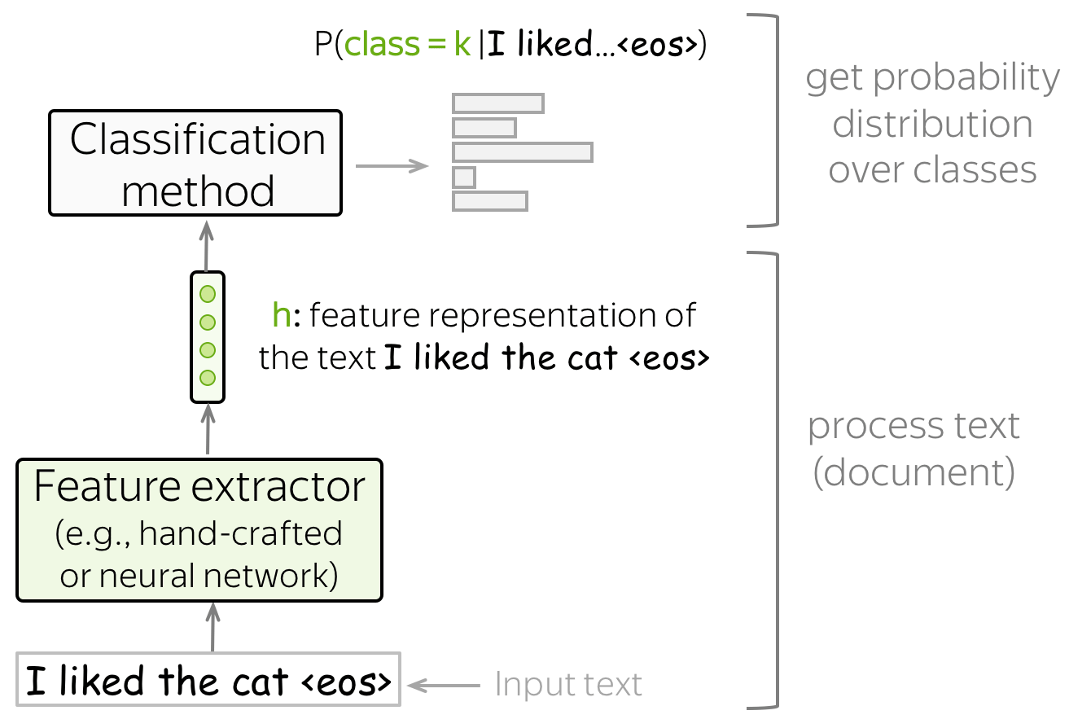
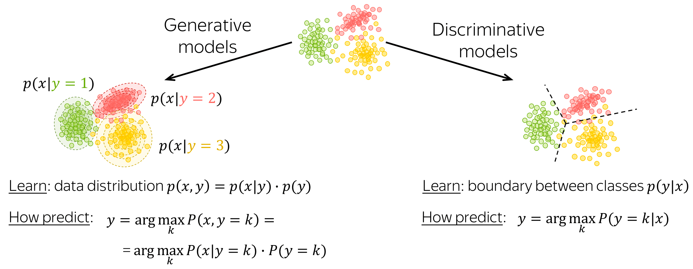
04
学习内容分享
RESEARCH RESULTS AND APPLICATIONS
Text Classification
A classification model can be either generative or discriminative.
Problem Solving Paradigm

Slide 26
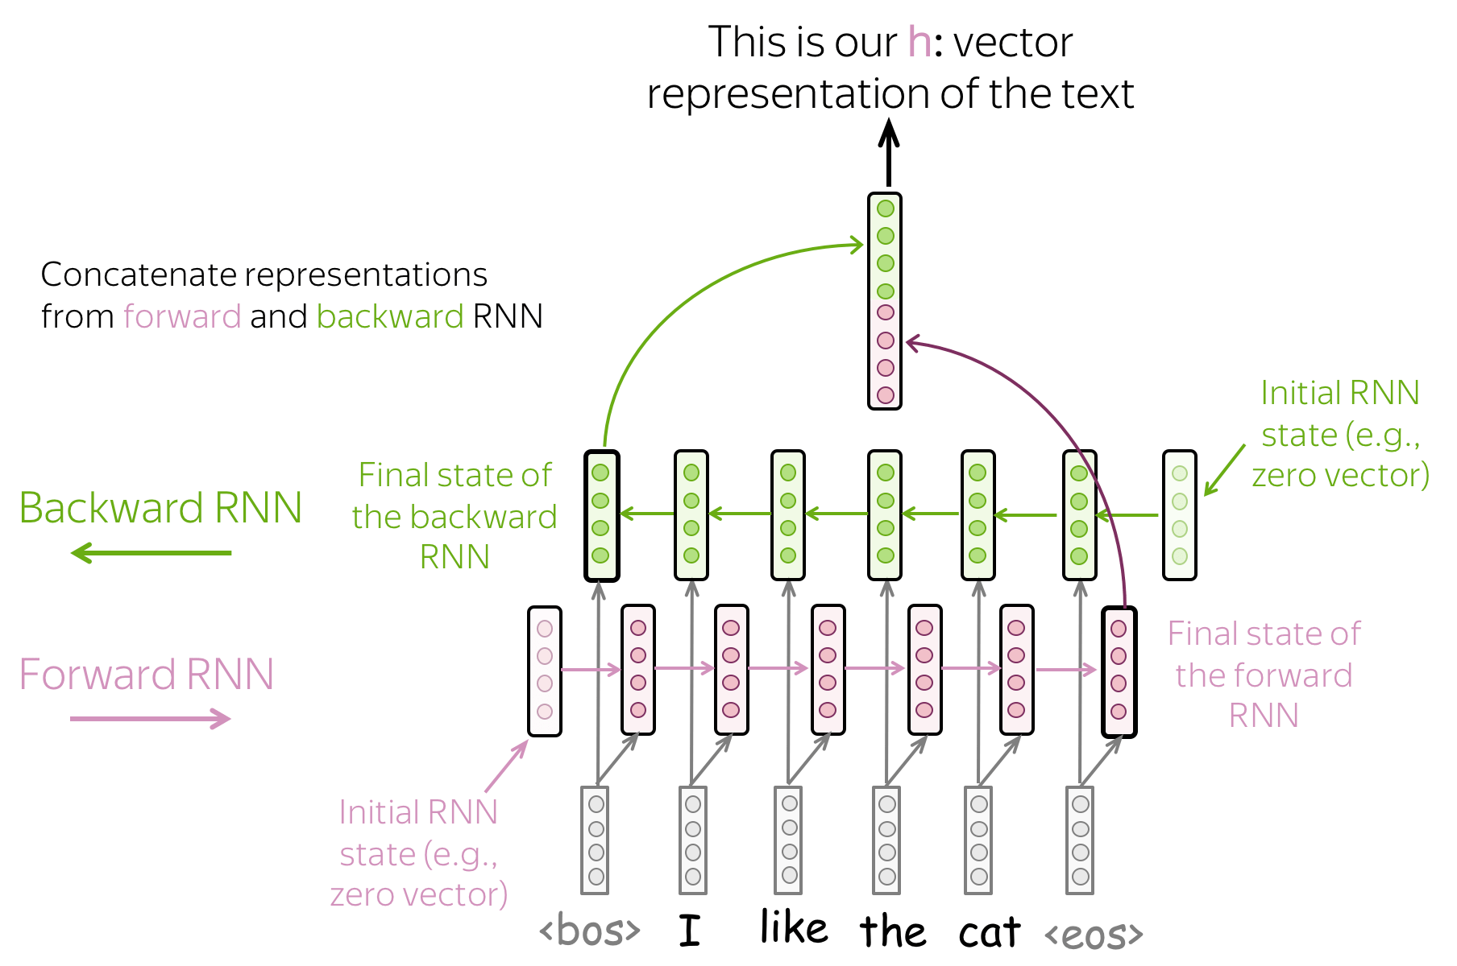
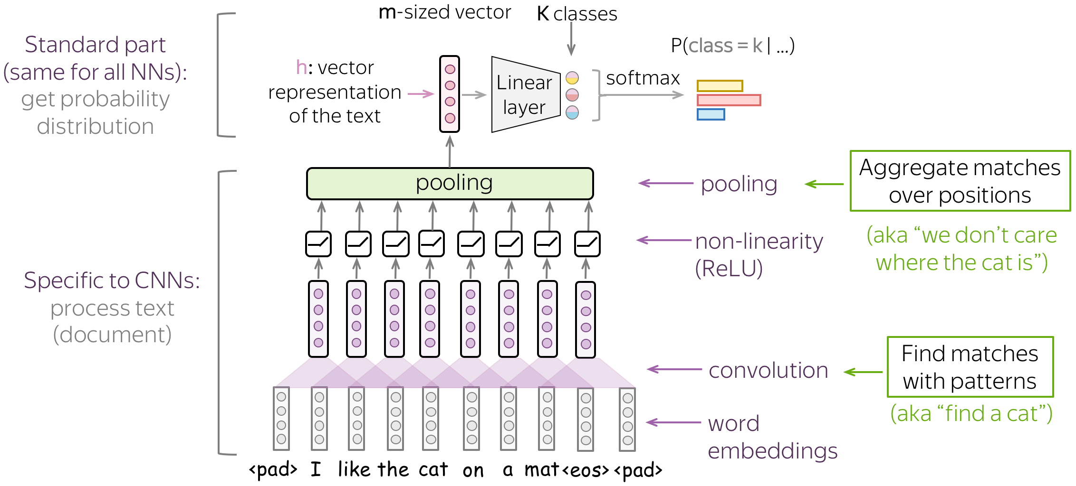
04
学习内容分享
RESEARCH RESULTS AND APPLICATIONS
Classical Methods
Naïve Bayes Classifier
Maximum Entropy Classifier (aka Logistic Regression)
SVM
Simple models.
I will not talk about here
BiRNN & BiLSTM
CNN: Translation Invariance

Slide 27
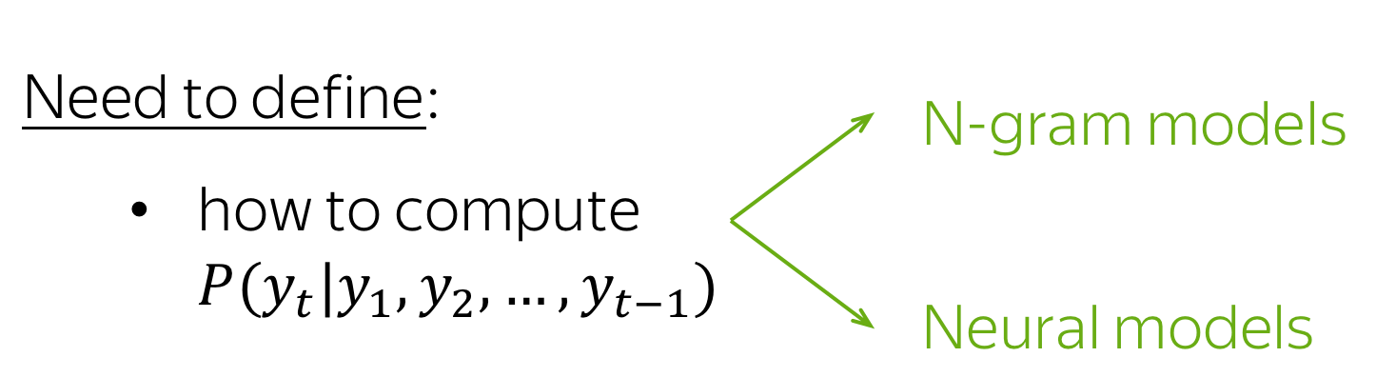
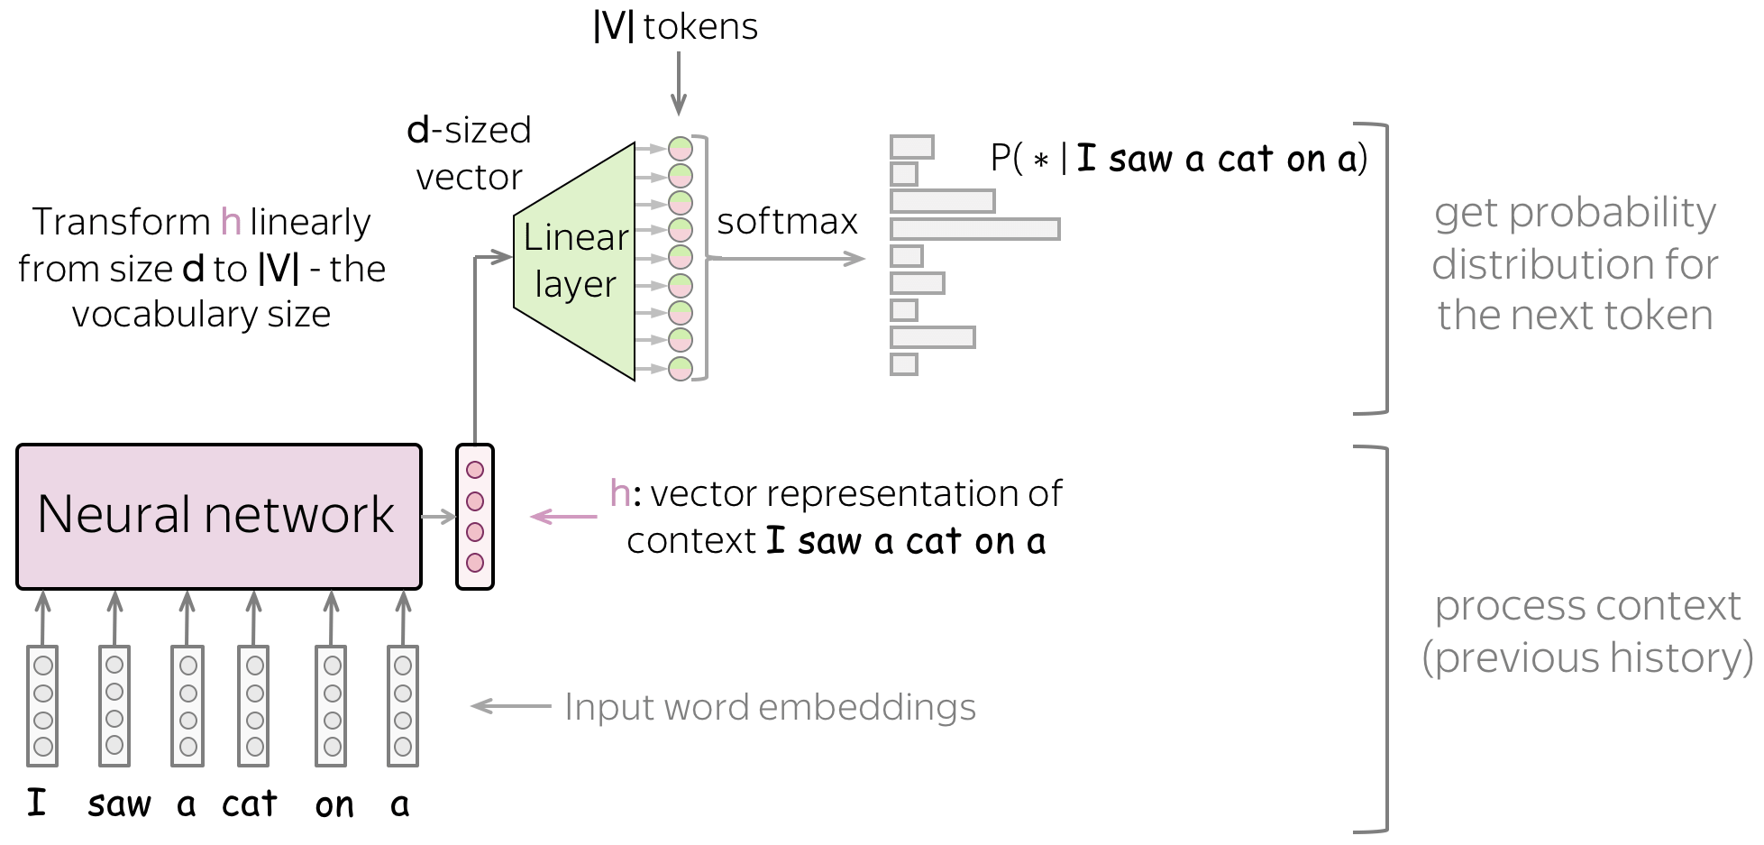
04
学习内容分享
RESEARCH RESULTS AND APPLICATIONS
For different model architectures, the general pipeline is as follows:
feed word embedding for previous (context) words into a network;
get vector representation of context from the network;
from this vector representation, predict a probability distribution for the next token.
Language Modeling
High Level pipeline
I will not mention the classical models such as N-grams LMS.

Slide 28
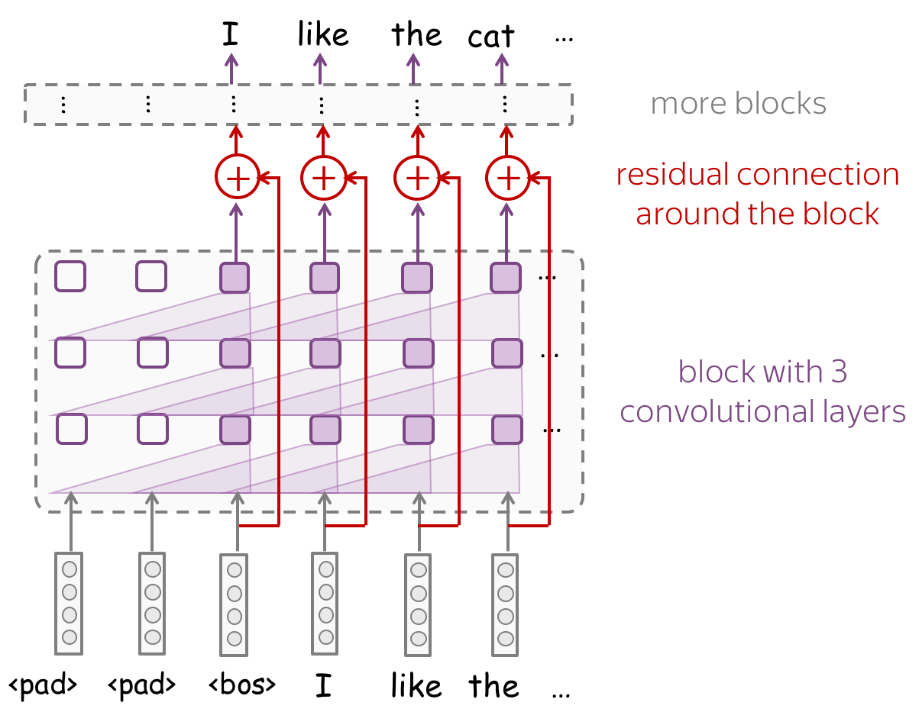
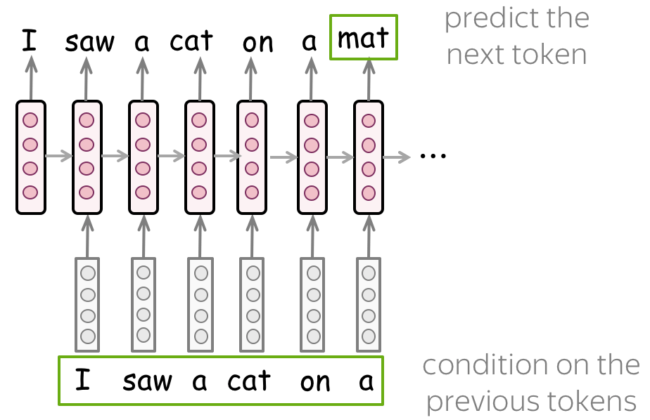
04
学习内容分享
RESEARCH RESULTS AND APPLICATIONS
CNN
BiRNN & BiLSTM

Slide 29
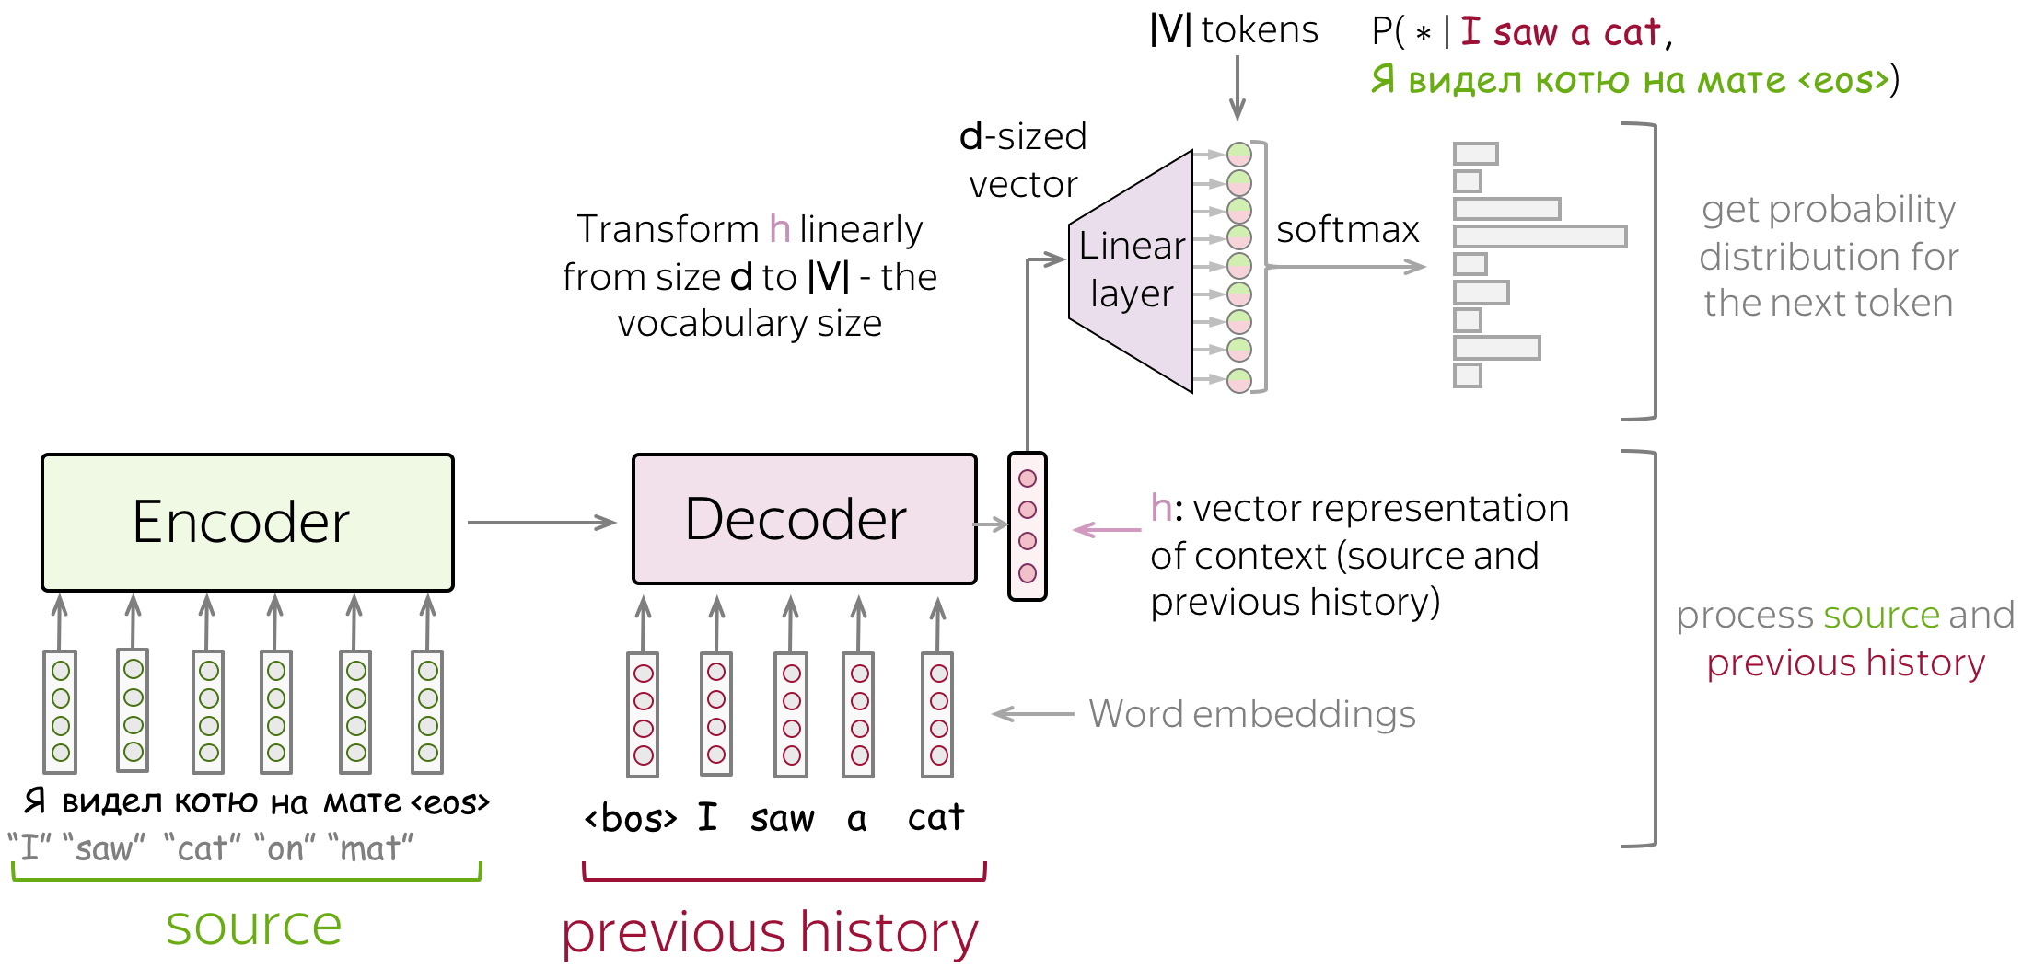
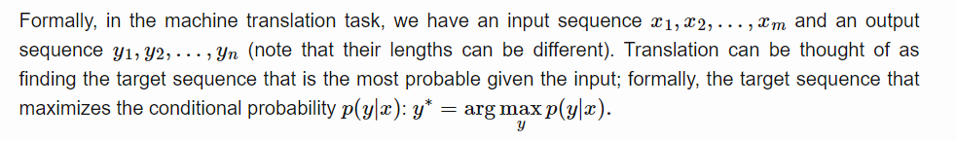
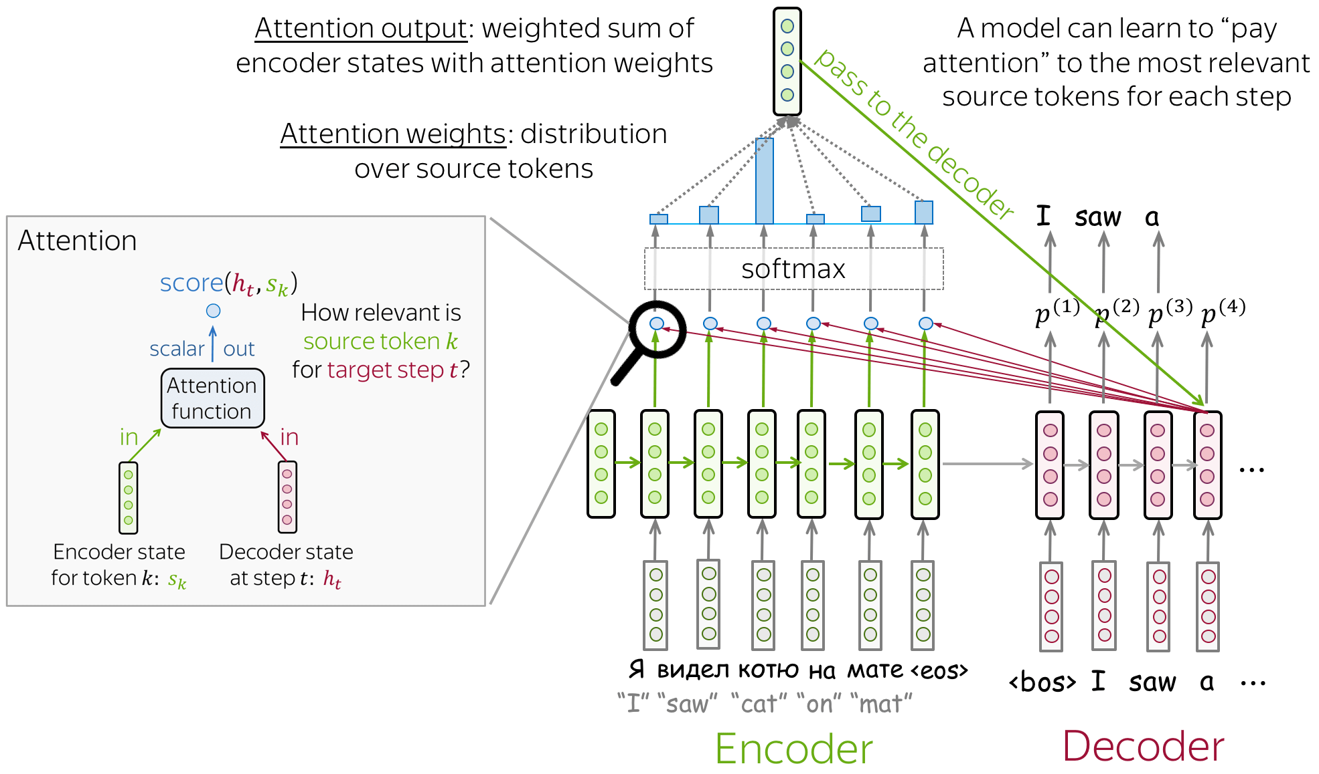
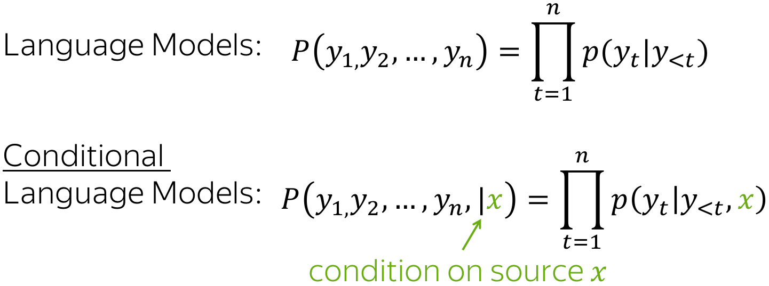
04
学习内容分享
RESEARCH RESULTS AND APPLICATIONS
High Level pipeline without attention mechanism
Sequence to Sequence (seq2seq) and Attention
With normal attention mechanism
Bahdanau Model

Slide 30

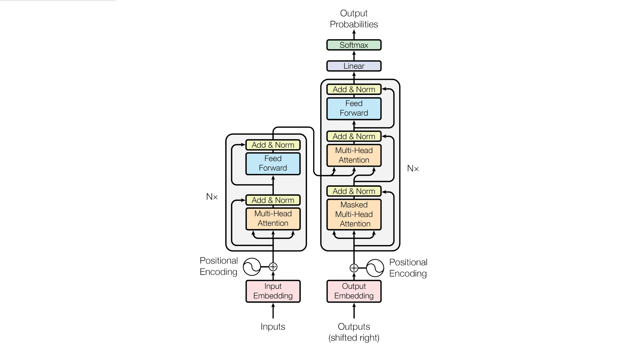
Transformer

Slide 31
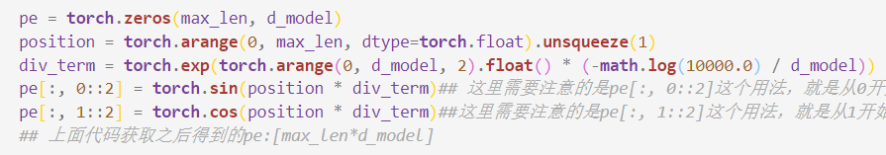
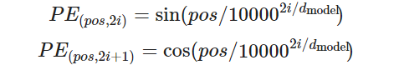

Slide 32
Encoder Part

Slide 33
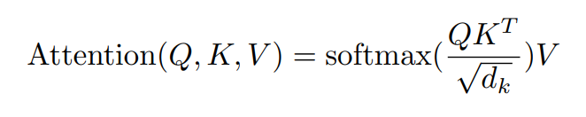
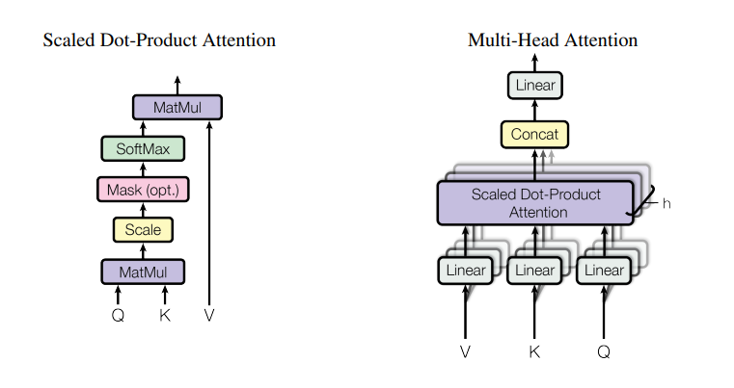

Slide 34
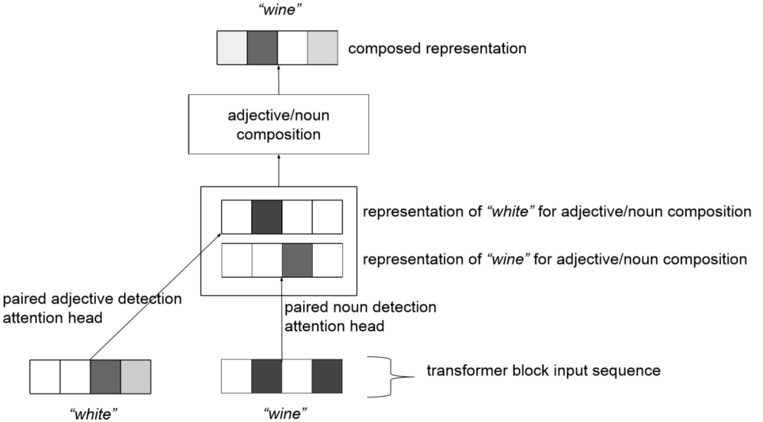
Relying on structured input from the attention heads, this neural network could perform various compositions. This might paly a role in disambiguation.

Slide 36
Decoder Part

Slide 40
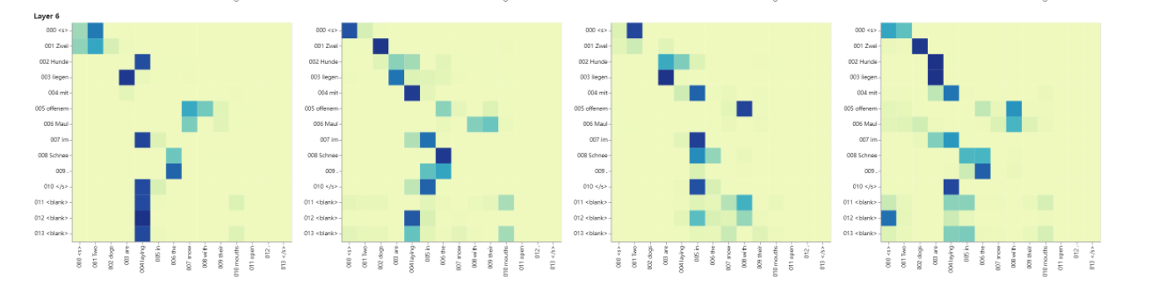
The attention score from my code

Slide 41
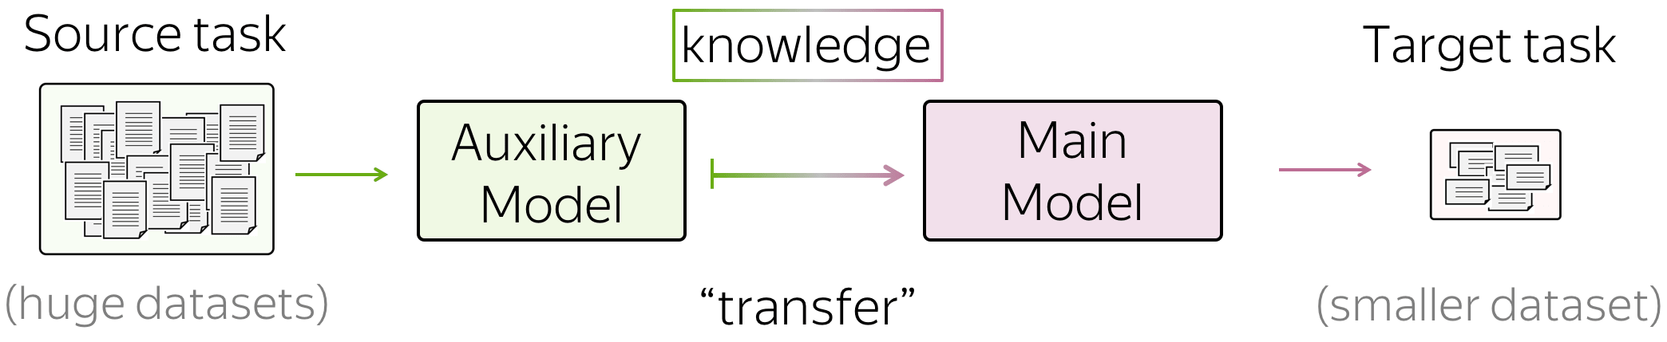
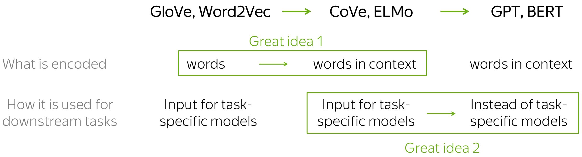
04
学习内容分享
RESEARCH RESULTS AND APPLICATIONS
Transfer learning

Slide 42
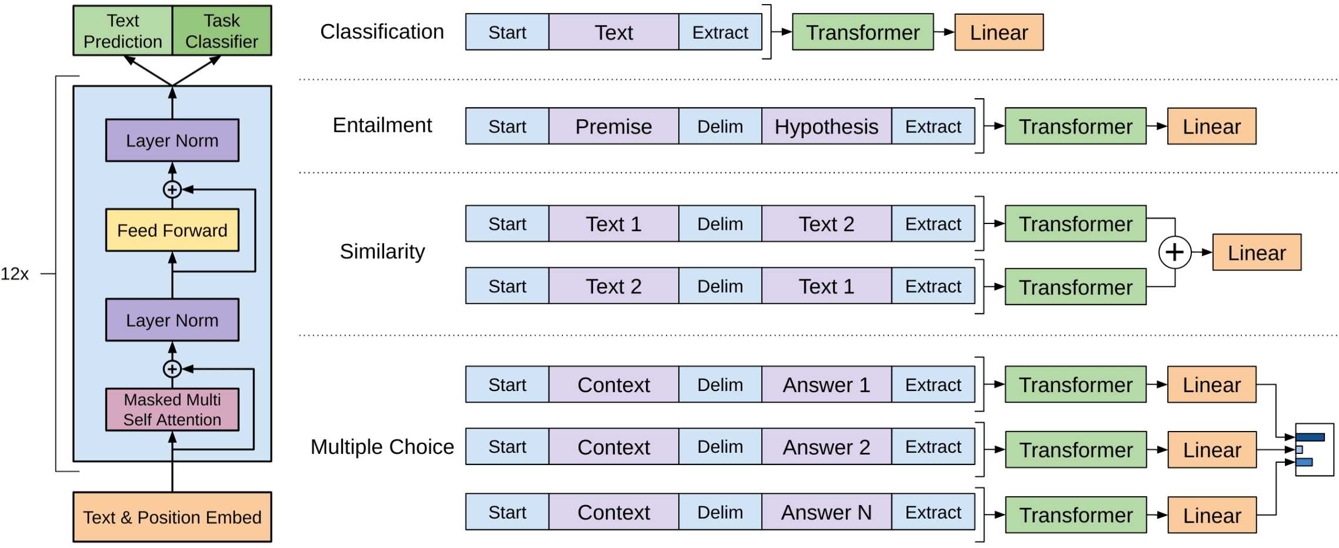
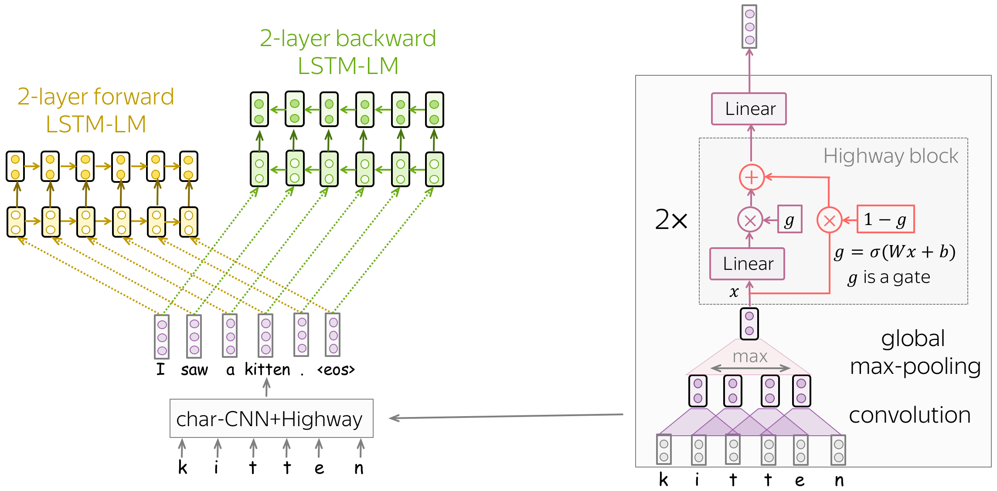
04
学习内容分享
RESEARCH RESULTS AND APPLICATIONS
GPT
ELMo

Slide 43
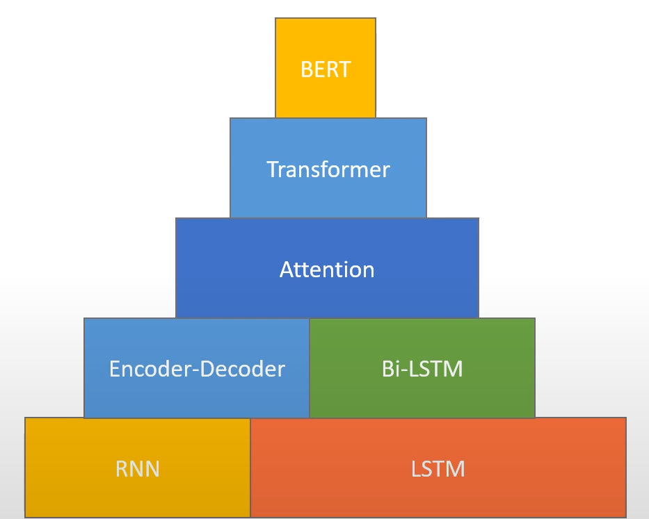
04
学习内容分享
RESEARCH RESULTS AND APPLICATIONS
Model learning

Slide 44
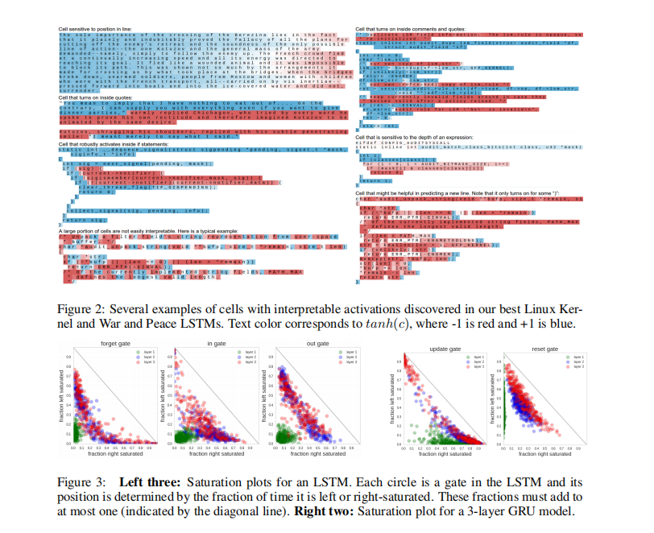
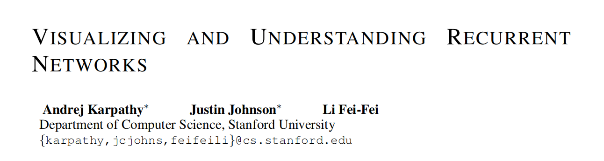
04
学习内容分享
RESEARCH RESULTS AND APPLICATIONS
I will not mention the detailed model implementation here, but from a high level view.

Slide 45
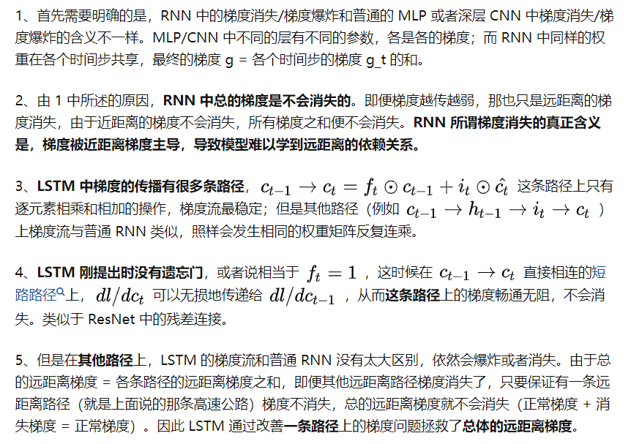
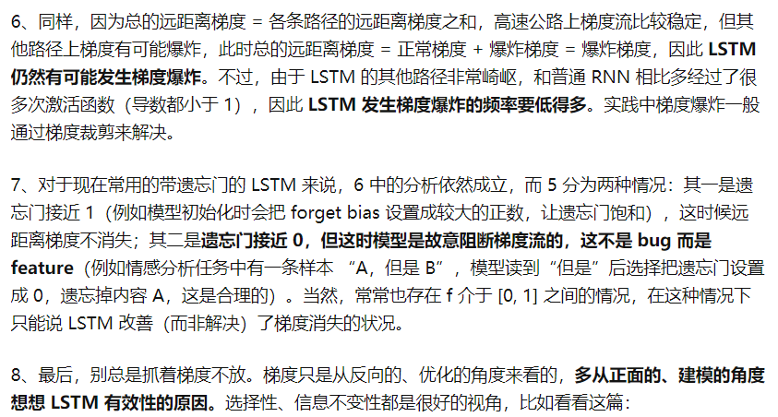
04
学习内容分享
RESEARCH RESULTS AND APPLICATIONS

Slide 46
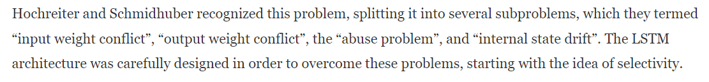
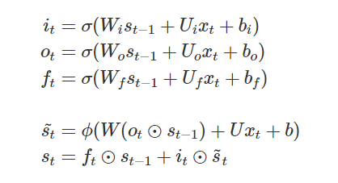
04
学习内容分享
RESEARCH RESULTS AND APPLICATIONS
From the view of information morphing:
Intuitive formula!

Slide 47
05
总结与展望
PAPER SUMMARY

Slide 48
05
总结与展望
PAPER SUMMARY
多模态&情感分析综述学习
Bert 变体的复现学习
论文学习 + 模型进一步魔改

Slide 49
结束
THANKS
答辩人：周绪睿

